Slide 1

Managerial Accounting
Marcelo Ortiz

Slide 2
Preparing and Analyzing Budget
1. Master Budget
2. Preparing Bugdets
3. Budget Control

Slide 3
1. Master Budget
Planning is one of management's major responsibilities.
Planning is the process of establishing objectives for the whole company.
A Budget is a formal written statement in financial terms of management's plans for a specified future time period.
Accounting information makes major contributions to the budgeting process.
From the accounting records, management obtains historical data on revenues, costs, and expenses. These data are helpful in setting future budget goals.
Accountants are responsible for presenting management's budgeting goals in financial terms.
It is not an easy jobs, it require to mix data from different sources and keep track of them, sometimes, manually.
2. Preparing Bugdets
3. Budget Control

Slide 4
1. Master Budget
Benefits of Budgeting:
It requires all levels of management to plan ahead and formalize goals regularly.
It provides definite objectives for evaluating performance at each level of responsibility.
It creates an early warning system.
It helps to coordinate unit objectives with the company’s goals.
It facilitates performance evaluation and respective rewarding.
2. Preparing Bugdets
3. Budget Control

Slide 5
1. Master Budget
Requirements for a good budgeting process:
- planning long enough… usually a year ahead.
- as many subperiods as it is useful: quarters, months, weekly. We will see that the budgeting process allows to have different time frames.
- an organizational structure that clearly defines authorities and responsibilities.
Types of organization structure: how are the responsibilities distributed?
a) functional form.
b) geographical form.
c) product-line form.
The decision rights must be tied to access to monitor budget variances.
- the decision-maker must be responsible to monitor the performance of his/her department relative to the budget.
- but not always is easy to compute budget variances: many wires to tie in the accounting information system.
2. Preparing Bugdets
3. Budget Control

Slide 6
1. Master Budget
The Budgeting Process:
- usually in the hands of the “Budget Committee”
- it starts several months before the beginning of the next planning year.
2. Preparing Bugdets
3. Budget Control

Slide 7
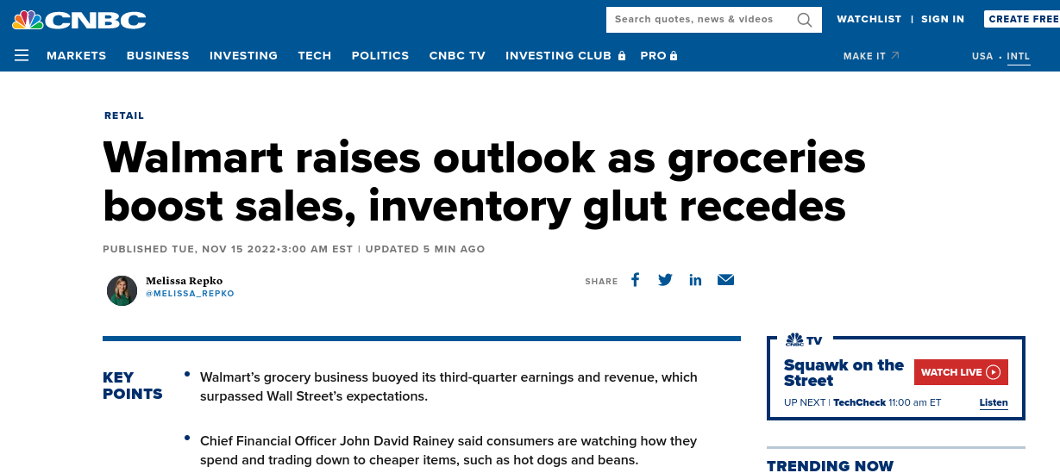
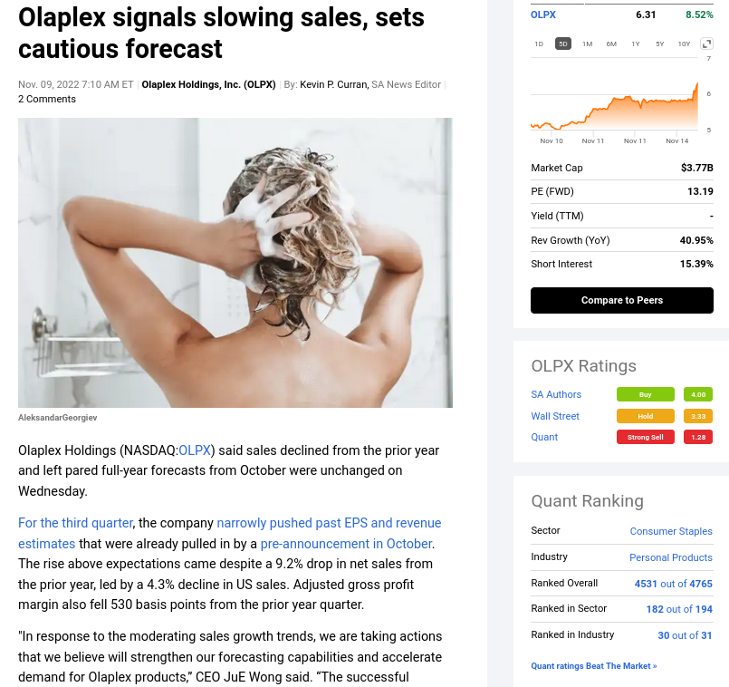
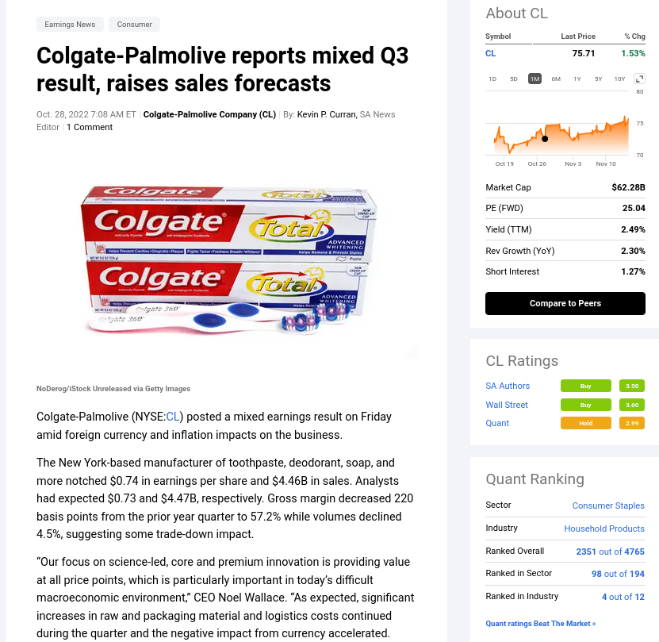
1. Master Budget
The Budgeting Process:
- usually in the hands of the “Budget Committee”
- it starts several months before the beginning of the next planning year.
2. Preparing Bugdets
3. Budget Control

Slide 8
1. Master Budget
Participative Budgeting:
- Bottom-up approach.
- Detailed knowledge of key factors in the hands of lower-level managers. Such as?
- Employees are more likely to see the resulting budget as fair.
Cons:
- It is more time-consuming.
- it creates incentives for budgetary gaming (e.g., overestimating budgeted expenses to make it easier to achieve).
- Budgets are closely tied to performance evaluation and thus, to employees' compensation.
- Ratchet effect.
2. Preparing Bugdets
3. Budget Control
Notes:
https://corporatefinanceinstitute.com/resources/accounting/bottom-up-budgeting/

Slide 9
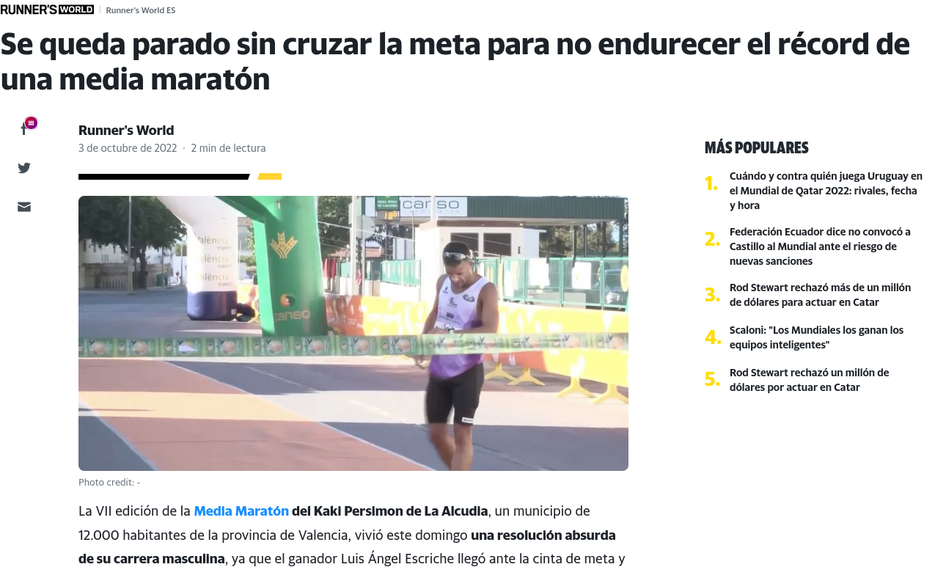
1. Master Budget
2. Preparing Bugdets
3. Budget Control

Slide 10
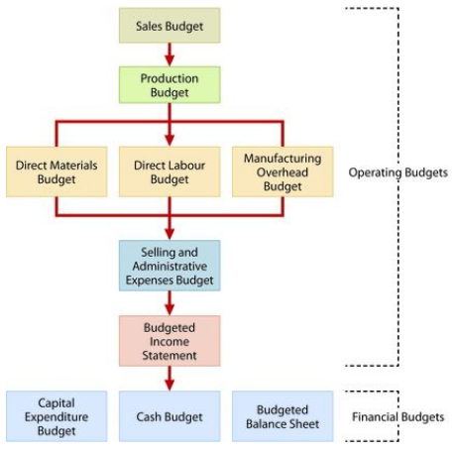
1. Master Budget
Components and steps
of the master budget:
2. Preparing Bugdets
3. Budget Control

Slide 11
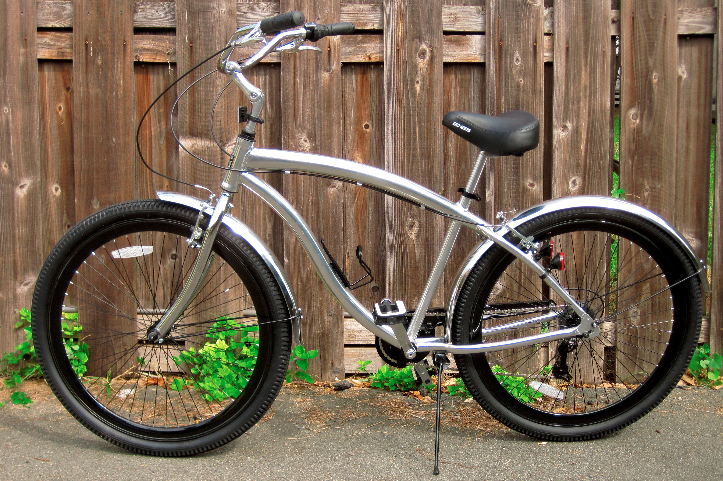
1. Master Budget
2. Preparing Bugdets
Let’s learn by doing:
Bicicletas Bicilona SA., is a Spanish company with a single product, BiciBeach, a bike ideal for riding streets and beaches.
3. Budget Control

Slide 12
1. Master Budget
2. Preparing Bugdets
Step 1: Sales budget
Management needs to have a solid estimate of sales for each quarter, month, or another relevant period, so they can determine how many units must be produced.
Sales Budget = expected sales volume per product * anticipated selling price per unit.
Bicilona expects to increase its sales by 500 units each quarter, starting with 3,000 units in the first quarter, considering a sale price of $60 per unit.
Some practitioner advice:
- use a method/function, easy to explain and justify.
- % sales growth: look at the industry or previous years.
- economic situation of customers/clients: unemployment, economic shocks.
- do not consider “discounted sale prices” in advance, low margin.
- backtesting: if you had used the same method in previous periods, did the method outperform or underperform systemically?
3. Budget Control

Slide 13
1. Master Budget
2. Preparing Bugdets
Step 2: Production budget
- once we have defined the unit of product to be expected to be sold, we have to compute the production requirements:
Budgeted Sales + Desired Ending Inventory- Beginning Inventory= Required Production Units
What are the consequences of an inadequate inventory in one period?
-Employee labor contract: flexible adaptation?
-cost of the warehouse.
-cost of inventories.
… remember the asset-efficiency metrics of Topics 3-4. To avoid lower these metrics, managers need to meet demand with enough inventory while avoiding paying for unnecessary storage.
Let’s jump to MS Excel.
3. Budget Control

Slide 14
1. Master Budget
2. Preparing Bugdets
Step 3: Direct Materials Budget
- we should already have calculated the cost of direct materials per unit (see previous lessons).
Units to be produced x Direct materials per unit = Direct Materials units required
Once we know the # of materials required, we calculate how many of them need to be purchased each quarter.
D. Materials units required+ Desired Ending D. Materials units - Beginning D. Materials units= Required D. Material units to be purchased
How many wheels need Bicilona on its inventory each quarter
3. Budget Control

Slide 15
1. Master Budget
2. Preparing Bugdets
Step 3: Direct Labor Budget
Managers need to know how much staff is needed to meet the production budget, and also their costs,
Hiring can take time.
New fixed contracts or overtime.
Labor regulation.
Units to be produced x Direct labor time per unit x Direct labor cost per hr = total Direct labor cost
In the example, assume that one worker needs 2 hrs to assemble a bike, and the cost per hr of labor is 10$
3. Budget Control

Slide 16
1. Master Budget
2. Preparing Bugdets
Step 4: Manufacturing Overhead Budget
Multiproduct: It can be done via the traditional or the ABC costing approach.
Important: if the cost behavior is variable then it is treated as occurring proportionally to the budgeted activity. If it is fixed, it is assumed constant across the budget period.
The main goal is to see how the variable and the fixed component of the overhead costs will change across the year.
In our example, we will assign variable overhead costs using just one driver: hours of labor.
Since, in this example, we have just one product, the assignment is just distributing variable costs across time, but in multi-product firms, the distribution will have multiple dimensions.
3. Budget Control

Slide 17
1. Master Budget
2. Preparing Bugdets
Step 5: S&A Budget
A Good (and very common approach) is to consider two components in this budget: a variable (as a function of the unit sold in each period) and a fixed component.
Variable S&A expenses: sales commissions, freight-out.
Fixed S&A expenses: salaries, stores' insurance.
3. Budget Control

Slide 18
1. Master Budget
2. Preparing Bugdets
Step 6: Budgeted Income Statement
At this point, we have all the elements for the estimated results in the budgeted period.
This step is critical for TMT and the Board:
Is the company getting the desired profitability for the owners?
Yes: continue
No, too low:
(a) how to improve the result?
(b) if not possible, inform to owners.
No, too high:
(a) are the assumptions too optimistic?
(b) is the result too sensitive to some parameters? (material costs, fuel price)
3. Budget Control

Slide 19
1. Master Budget
2. Preparing Bugdets
Step 7: Cash budget
The goal is to see the expected cash flows during the budget period.
This is not a trivial task since many sales and expenses are registered on an accrual basis rather than a cash basis.
For example, sales in month 1 can be paid in month 2: while sales are registered in one month, there is no cash inflow until the next month.
Ideally, it should be a monthly budget.
The cash budget is a key decision tool for treasurers.
(1) can we sell on credit? How long can the trade credit be, 30 or 90 days?
(2) will we have the cash to buy the materials when needed?
(3) will we have the cash to meet financial obligations? Salaries, loans, and taxes.
It has three sections: cash receipts, cash disbursements, and financing.
3. Budget Control

Slide 20
1. Master Budget
2. Preparing Bugdets
Step 7: Cash budget
Cash receipts:
Cash sales.
Collection from customers on credit sales.
Receipts of interest and dividends.
Sales of investments and other stocks.
Cash disbursements:
Payments of direct materials, labor, overhead costs, and S&A expenses.
Payments for income taxes, dividends, and investments.
Financing:
Borrowings and repayments of funds plus interest.
3. Budget Control

Slide 21
1. Master Budget
2. Preparing Bugdets
Step 7: Cash budget
Example:
Simplification: quarter budget.
Assumption:
60% of sales are collected in the quarter sold, and 40% are collected in the following quarter.
50% of purchases are paid in the quarter purchased, and 50% are paid in the following quarter.
Cash balance is expected to be $38.000 for January 1, 2020.
ST-investment are expected to be sold for $2.000 cash in the first quarter.
Direct labor is 100% paid in the quarter incurred.
S&A (except depreciation) expenses are paid in the quarter incurred.
Machine purchase: $10.000 in the second quarter in cash.
Quarterly payments of its estimated annual income taxes.
Loans are paid as soon as possible; the minimum required is $15.000.
3. Budget Control

Slide 22
1. Master Budget
2. Preparing Bugdets
Step 8: Budgeted Balance Sheet
It is a projection of the company's financial position at the end of the budget period.
Starting points: the budgeted balance sheet of the preceding year and the budget of the current year.
Notice that at the end of Step 8, managers can compute most of the financial ratios with the budgeted data, so they can look at how others will evaluate their work if the assumptions hold.
Example:
Information from the current year:
- Buildings and equipment: $192.000.
- Accumulated depreciation: $28.800.
- Common shares: $225.000.
- Retained earnings: $46.480.
3. Budget Control

Slide 23
1. Master Budget
2. Preparing Bugdets
Step 10: What-if analyses
Once all the budgets are entered into the company's software, it is common to prepare what-if analyses.
The idea is to see how the budgeted profit, cash balance, and financial situation change in an alternative set of assumptions.
- useful for anticipating problems.
- what factors/assumptions should be monitored more frequently?
- can managers reduce uncertainty in these assumptions? Negotiating long-term price arrangements with providers and fidelity plans for customers.
3. Budget Control

Slide 24
1. Master Budget
2. Preparing Bugdets
3. Budget Control
Variance analysis: terminology
Variance
Difference between an actual result and a budgeted amount.
Favorable Variance (denoted F)
A variance that increases operating income.
Actual revenues are higher than budgeted.
Actual expenses are lower than budgeted.
Unfavorable Variance (denoted U)
A variance that decreases operating income.
Actual revenues are lower than budgeted.
Actual costs are higher than budgeted.

Slide 25
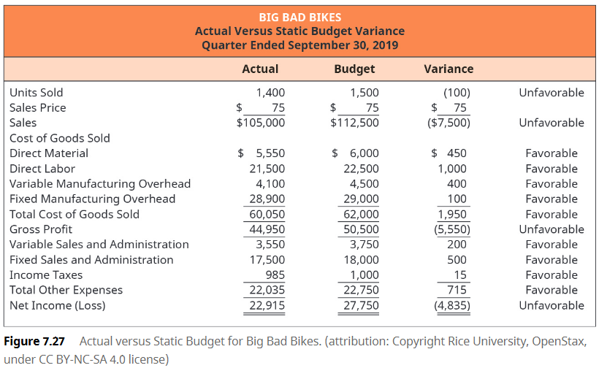
1. Master Budget
2. Preparing Bugdets
3. Budget Control
Variance analysis: example

Slide 26
1. Master Budget
2. Preparing Bugdets
3. Budget Control
Variance analysis:
Evaluating the actual results versus the estimated budgetary results can help management plan for the future. It does not necessarily find a problem, but it does indicate where a problem may exist.
Important: favorable variance does not mean it is a good thing. For example, lower direct material costs can be driven by pessimistic forecasts, managerial inefficiency in handling the budgeted production level, or reductions in materials quality.
Similarly, unfavorable variances are not necessarily bad: higher direct labor costs might be related to hiring better workers that waste less materials

Slide 27
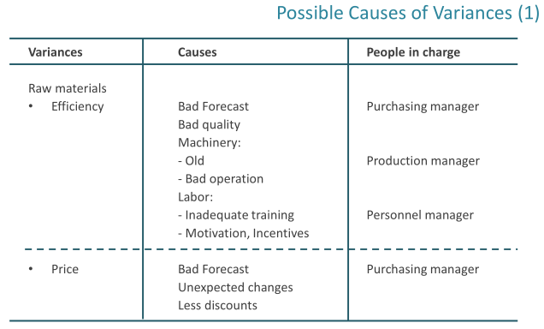
1. Master Budget
2. Preparing Bugdets
3. Budget Control

Slide 28
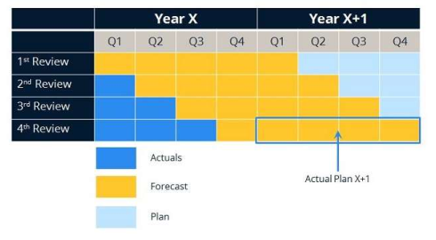
1. Master Budget
2. Preparing Bugdets
3. Budget Control
Beyond Budgeting:
Rolling Forecast with no rigid objectives
- reduce Budget gaming at the end of the Budget period… since there is not "final quarter."
- allow management to respond to changes in estimates or actual occurrences.
- it takes management away from other duties as it requires continual updating

